Slide 1
3.2 String Funtions

Slide 2
Objectives
To understand the fundamentals of Strings and Characters
To learn how to work with array of Strings
To learn the usage of String Manipulation Functions
To learn how to do sorting of strings

Slide 3
Agenda
Array of Strings
String Manipulation Functions
Explanation with examples
Sorting of strings

Slide 4
Arrays of Strings
Since one string is an array of characters, a two dimensional array of characters is an array of strings in which each row is one string.
char names[People][Length];
This can be initialized as follows:
char month[5][10] = {“January”, “February”, “March”, “April”, “May”};

Slide 5
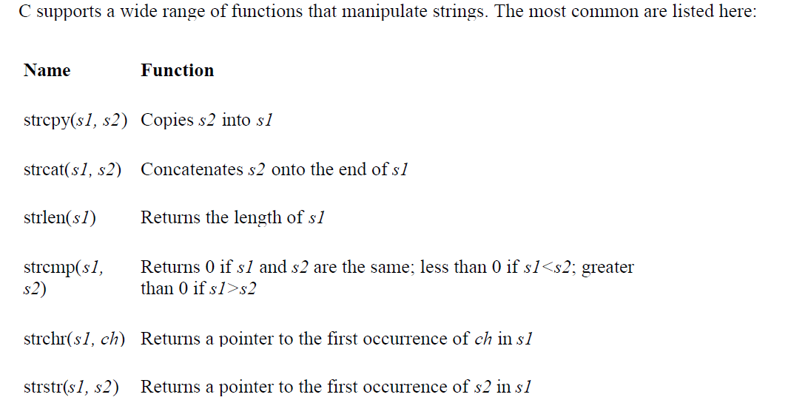
String Manipulation Functions

Slide 6
strcpy
strcpy(destinationstring, sourcestring)
Copies sourcestring into destinationstring
For example
strcpy(str, “hello world”); assigns “hello world” to the string str

Slide 7
Example with strcpy
#include <stdio.h>
#include <string.h>
main()
{
char x[] = “Example with strcpy”;
char y[25];
printf(“The string in array x is %s \n “, x);
strcpy(y,x);
printf(“The string in array y is %s \n “, y);
}

Slide 8
strcat
strcat(destinationstring, sourcestring)
appends sourcestring to right hand side of destinationstring
For example if str had value “a big ”
strcat(str, “hello world”); appends “hello world” to the string “a big ” to get
“ a big hello world”

Slide 9
Example with strcat
#include <stdio.h>
#include <string.h>
main()
{
char x[] = “Example with strcat”;
char y[]= “which stands for string concatenation”;
printf(“The string in array x is %s \n “, x);
strcat(x,y);
printf(“The string in array x is %s \n “, x);
}

Slide 10
strcmp
strcmp(stringa, stringb)
Compares stringa and stringb alphabetically
Returns a negative value if stringa precedes stringb alphabetically
Returns a positive value if stringb precedes stringa alphabetically
Returns 0 if they are equal
Note lowercase characters are greater than Uppercase

Slide 11
Example with strcmp
#include <stdio.h>
#include <string.h>
main()
{
char x[] = “cat”;
char y[]= “cat”;
char z[]= “dog”;
if (strcmp(x,y) == 0)
printf(“The string in array x %s is equal to that in %s \n “, x,y);
(Cntd in next slide)

Slide 12
Example with strcmp (Cntd)
if (strcmp(x,z) != 0)
{printf(“The string in array x %s is not equal to that in z %s \n “,
x,z);
if (strcmp(x,z) < 0)
printf(“The string in array x %s precedes that in z %s \n “, x,z);
else
printf(“The string in array z %s precedes that in x %s \n “, z,x);
}
else
printf( “they are equal”);
}

Slide 13
strlen
strlen(str) returns length of string excluding null character
strlen(“tttt”) = 4 not 5 since \0 not counted

Slide 14
Vowels Example with strlen
#include <stdio.h>
#include <string.h>
main()
{
int i, count;
char x[] = “tommy tucket took a tiny ticket ”;
count = 0;
for (i = 0; i < strlen(x);i++)
{
if ((x[i]==‘a’)||(x[i]==‘e’)||(x[i]==‘I’)||(x[i]==‘o’)||(x[i]==‘u’))
count++;
}
printf(“The number of vowels’s in %s is %d \n “, x,count);
}

Slide 15
String Manipulation Functions - Predict the output
#include <stdio.h>
#include <string.h>
int main(void)
{
char s1[80], s2[80];
gets(s1);
gets (s2);
printf("lengths: %d %d\n", strlen(s1), strlen(s2));

Slide 16
String Manipulation Functions – Predict the output (Cntd)
if(!strcmp(s1, s2)) printf("The strings are equal\n");
strcat(s1, s2);
printf (''%s\n", s1);
strcpy(s1, "This is a test.\n");
printf(s1);
if(strchr("hello", 'e')) printf("e is in hello\n");
if(strstr("hi there", "hi")) printf("found hi");
return 0;
}
If you run this program and enter the strings "hello" and "hello", the output is (next slide)

Slide 17
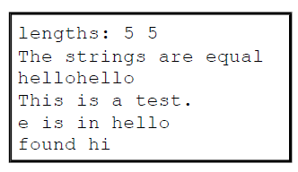
String Manipulation Functions – Example Program output

Slide 18
Program for sorting of strings
#include<stdio.h>
int main(){
int i,j,n;
char str[20][20],temp[20];
puts("Enter the no. of string to be sorted");
scanf("%d",&n);
for(i=0;i<=n;i++)
gets(str[i]);
for(i=0;i<=n;i++)
for(j=i+1;j<=n;j++)

Slide 19
Program for sorting of strings (Cntd)
{
if(strcmp(str[i],str[j])>0){
strcpy(temp,str[i]);
strcpy(str[i],str[j]);
strcpy(str[j],temp);
}
}
printf("The sorted string\n");
for(i=0;i<=n;i++)
puts(str[i]);
return 0;
}

Slide 20
Summary
Learned about array of strings
String manipulation functions with examples
Learned how to do sorting of strings

Slide 21
strchr
#include <stdio.h> #include <string.h> int main() { char *s; char buf [] = "This is a test"; s = strchr(buf,'t'); if (s != NULL) printf ("found a 't' at %s\n", s); return 0; }

Slide 22
#include <stdio.h> #include <string.h> int main(void) { char s1[80], s2[80]; char *c,*d; gets(s1); gets (s2); printf("lengths: %d %d\n", strlen(s1), strlen(s2)); if(!strcmp(s1, s2)) printf("The strings are equal\n"); strcat(s1, s2); printf ("%s\n", s1); strcpy(s1, "This is a test.\n"); printf("%s",s1); if(strchr("hello", 'e')) printf("e is in hello\n"); c=strchr("hello", 'e'); printf("c=%p\n",c); if(strstr("hi there", "hi")) printf("found hi\n"); d=strstr("hi there", "hi"); printf("d=%p\n",d); return 0; }
stdin
cat cat
stdout
length : 3 3 the strings are equal catcat this t e is in hello found hi

